Slide 1

Group B Wrong Way Airlines meets Misdirected Deliveries, Inc.
By: Prutha Patel
Ahmed Mansour
Salman Nawaz
Lean Barredo

Slide 2
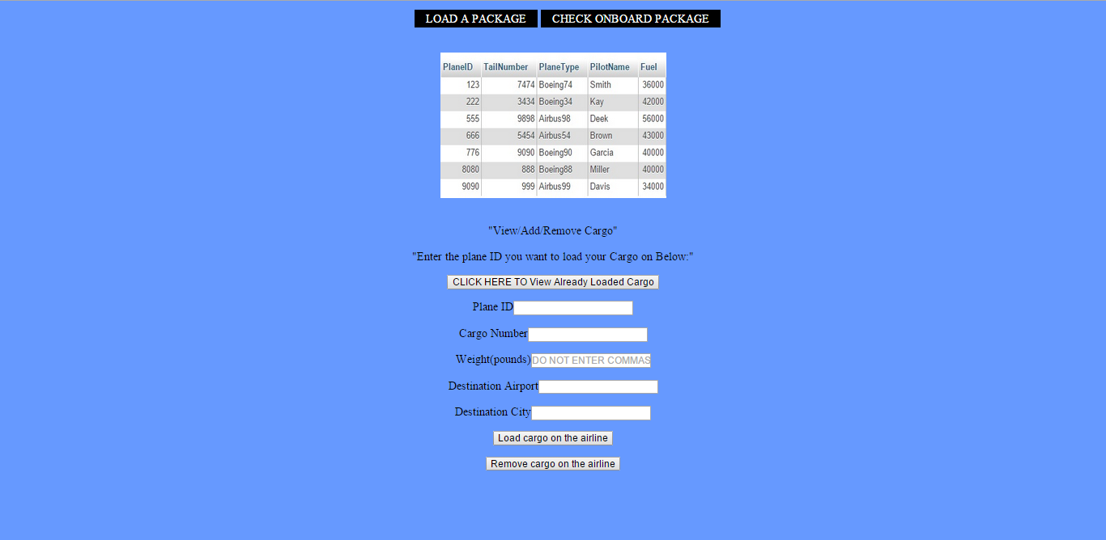

Slide 3
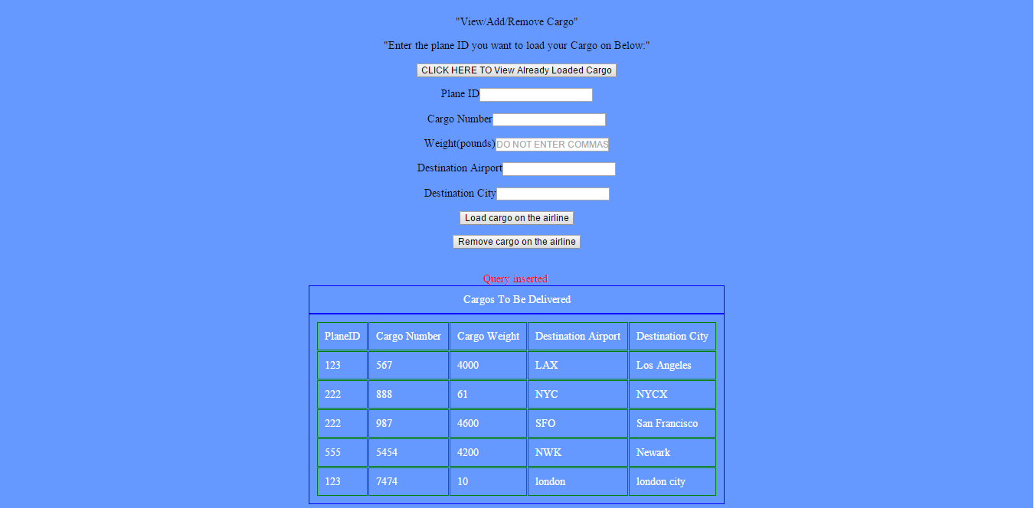

Slide 4
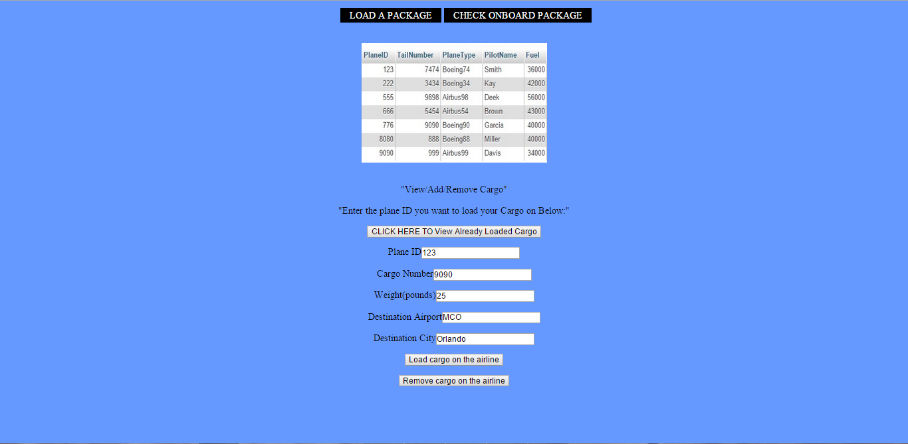

Slide 5
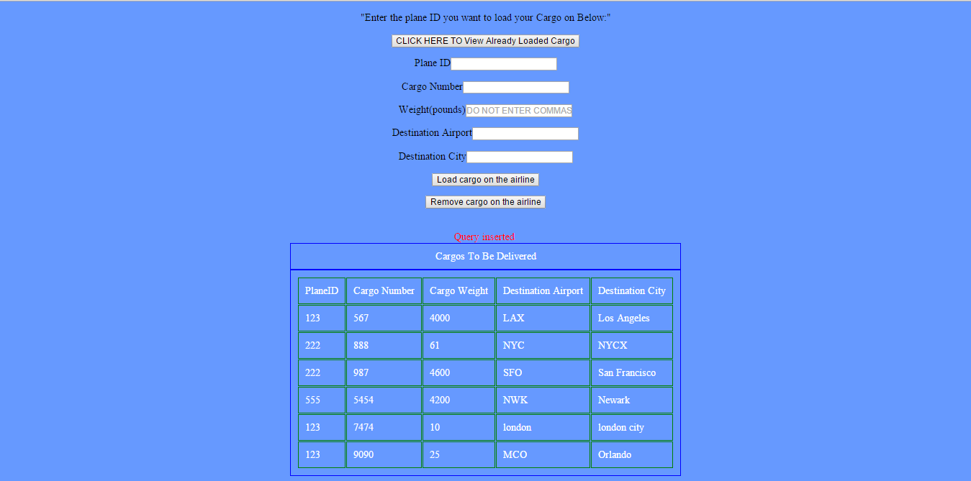

Slide 7
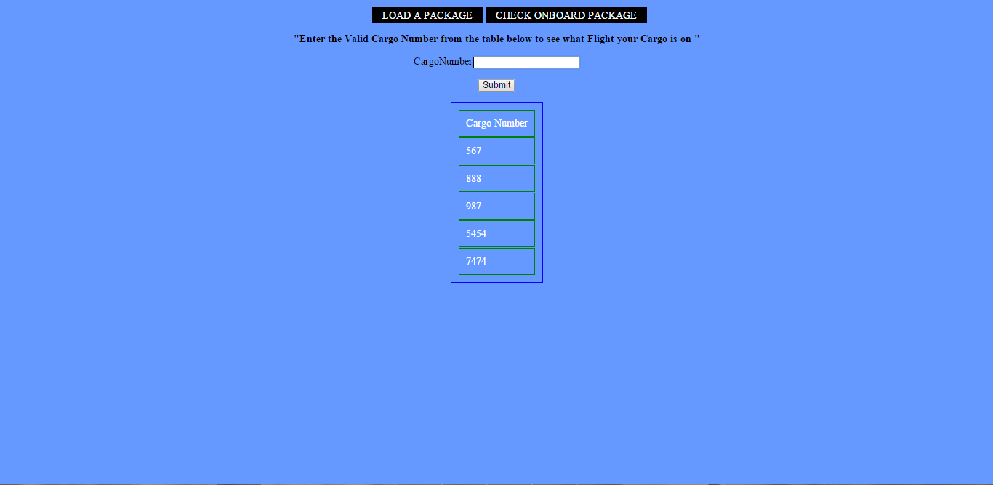

Slide 8
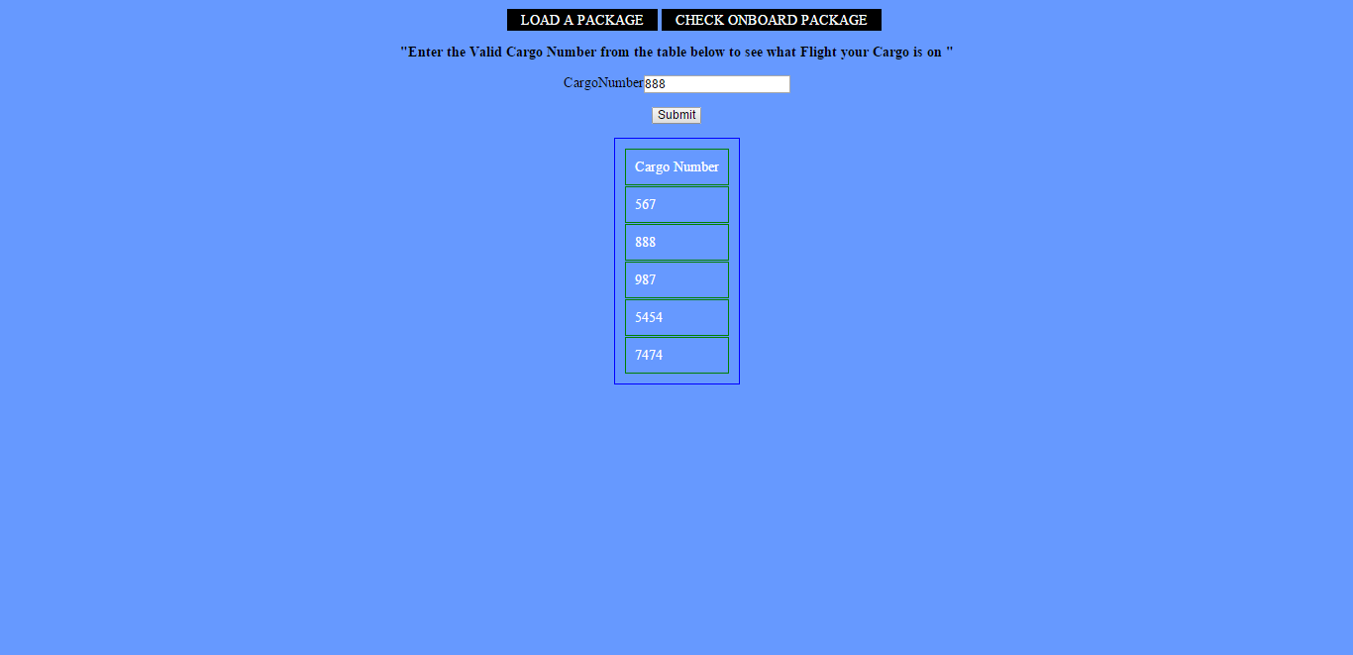

Slide 9
